Slide 1

Understanding the 'why' around neurodivergent inclusive web design
IAAP
Owen Niblock
owenniblock@github.com
Slides: https://github.com/owenniblock/owenniblock/tree/main/talks

Slide 2
Agenda
About me & my place in GitHub
Some things about Neurodiversity in general
Content Guidance
General Accessibility guidelines
Conclusions
Q&A
Style Guidance
Functional Guidance

Slide 3
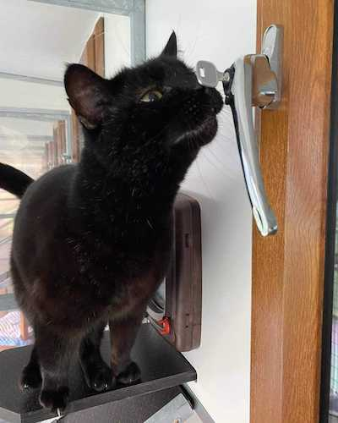

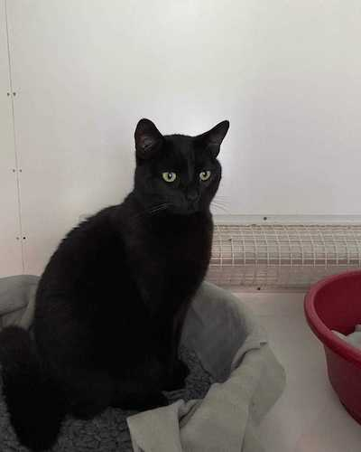
Who am I?
@owenniblock: Undiagnosed Autistic, SOFTWARE Engineer, GitHub Employee, Owner of Cats, Lover of Star Trek, Part-Time comedian, full-time weirdo.

Slide 4
Neurodivergence @ GitHub
Hooray for the Neurocats

Slide 5
Neurodiversity vs. Neurodivergence
Neurodiversity: The array of all different ways of our brains working. Includes what’s considered typical.
Neurodivergence: People with cognitive functioning that differs from what’s considered typical.

Slide 6
Neurodivergence
Neurodivergence Includes:
Autism
ADHD
Dyslexia
Aphantasia
Mental health conditions
Many, many more

Slide 7
This is not exhaustive
Notes:
Both the list of facets of neurodivergence and the list of potential problems ND folk have with websites. The intention of this talk is to foster empathy and thoughtfulness and to suggest ways to continue learning.

Slide 8
Content Guidance
Notes:
Both the list of facets of neurodivergence and the list of potential problems ND folk have with websites. The intention of this talk is to foster empathy and thoughtfulness and to suggest ways to continue learning.

Slide 9
Animations & things that move
Prefers-reduced-motion - CSS: cascading style sheets | MDN (mozilla.Org)
Ability to pause
Unexpected movement is even worse

Slide 10
Noise
No thank you!

Slide 11
Video tutorials
Inconsistent processing speed
Provide alternative methods

Slide 12
Make it clear and as simple as possible
Plain language
Simple sentences
Active voice
Notes:
Example of active voice vs passive voice: Owen gave a talk. A talk was given by Owen.

Slide 13
Implied & ambiguous content
I will misunderstand or miss information

Slide 14
Captions
Another processing thing

Slide 15
Show me the price
If it takes me ages to find out how much something costs, I won’t want it

Slide 16
Style Guidance
Notes:
Both the list of facets of neurodivergence and the list of potential problems ND folk have with websites. The intention of this talk is to foster empathy and thoughtfulness and to suggest ways to continue learning.

Slide 17
Font choice matters
Follow British Dyslexia’s style guide
Notes:
Use sans-serif, make text large enough, pay attention to contrast and backgrounds

Slide 18
Don’t reinvent the web…

Slide 19
I do not expect the unexpected
Notes:
You’re half way Owen. Keep going!

Slide 20
Consistency is key

Slide 21
Colours & Contrast
Avoid bright colours?
High contrast?
Options!

Slide 22
Functional Guidance
Notes:
Both the list of facets of neurodivergence and the list of potential problems ND folk have with websites. The intention of this talk is to foster empathy and thoughtfulness and to suggest ways to continue learning.

Slide 23
Give me time
You have failed the task
Log back in, lose your work spoon theory

Slide 24
Let me fail
… But help me succeed

Slide 25
Help me make decisions
Explain the consequences
Let me change my mind

Slide 26
Sometimes I’ll take the long way round
The scenic route can give me comfort,
Require less cognitive overhead,
And be easier for me to navigate.

Slide 27
Help me find stuff
Sometimes I find it hard to remember where stuff is

Slide 28
I do not like change (to start with)

Slide 29
Where did it go?
Toasts and warnings that disappear don’t help me

Slide 30
Notification fatigue is a thing

Slide 31
Just help me
Human contact in various forms never seems to happen any more ☹
Notes:
Twitter / X top tip!

Slide 32
General Accessibility Guidance & Resources
Notes:
Both the list of facets of neurodivergence and the list of potential problems ND folk have with websites. The intention of this talk is to foster empathy and thoughtfulness and to suggest ways to continue learning.

Slide 33

Web Accessibility Guidelines
WCAG: web content accessibility guidelines (WCAG) 2.1 (w3.Org)
COGA: making content usable for people with cognitive and learning disabilities (w3.Org)

Slide 34
Some Microsoft Design Guidelines & Tools
Inclusive design for cognition guidebook (PDF)
Mental health guidebook (pdf)

Slide 35
Other Useful Resources
UK gov: dos and don’ts on designing for accessibility
Github blog: how github supports neurodiverse employees (and how your company can, too)
Notes:
Oh my, the posters the UK gov design team created are glorious & incredibly useful.

Slide 36
Want To Be Inclusive?
Engage with the community!
Create space for a community

Slide 37
Conclusions
Be kind
Ask questions
Keep learning

Slide 38
The End | Chat ☺
Safe space vibes
Meeting is recorded
Oversharing is a thing

